Slide 1
Bitcoin: A Peer-to-Peer Electronic Cash System
Author: Satoshi Nakamoto
Speaker：Lizhi Xing

Slide 2
Agenda
01
Background
02
Transactions
Motivation
Author
Personal Story
03
Tools & Mechanisms
04
Community Elements
Timestamp Server
Proof-of-Work
Reclaiming Disk Space
Incentive
Privacy
Hacker Attacks
05
Opinions

Slide 3
01
Background

Slide 4
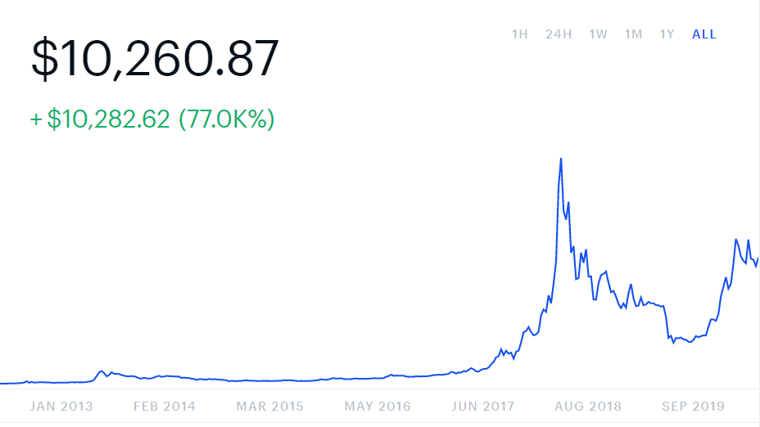
Background：Personal Story
+Machines: $30,000
+Electricity: $450x12
Bitcoin: $13,000
Salvage: $15,000
Time to purchase mining machines
Time to start mining
A Lot !
Time to quit
4

Slide 5
Background：Motivation
Traditional Way—Trust based models
Third Party Transactions
Features (disadvantages):
Reversible but costly
Need a lot of client information
A certain percentage of fraud is accepted as unavoidable
Fate of the system relies on the central authority—solve double-spending problem
Desired System
Peer-to-Peer Network: no trusted central authority needed
Features (advantages):
Irreversible
Little client information is needed
No fraud
5

Slide 6
Background：Author
Author
Satoshi Nakamoto
A person, or a group of people?
A leader is best when people barely know he exists, when his work is done, his aim fulfilled, they will say: we did it ourselves.
——Lao Tzu
6

Slide 7
02
Transaction

Slide 8
Transaction: Terminology
Cryptocurrency
Double-spending
A cryptocurrency is a digital asset designed to work as a medium of exchange that uses strong cryptography to secure financial transactions, control the creation of additional units, and verify the transfer of assets.
Double-spending is a potential flaw in a digital cash scheme in which the same single digital token can be spent more than once.
Example：
Amy has only $100 in her banking account. She wrote two checks each worth $100 to Bob and Cathy respectively.
What is Bitcoin?
Hash
An electronic coin is a chain of digital signatures.
A hash algorithm is a function that converts an input of letters and numbers into an encrypted output of a fixed length. This output is called a hash.
8
Notes:
"Hash" is really a broad term with different formal meanings in different contexts.

Slide 9
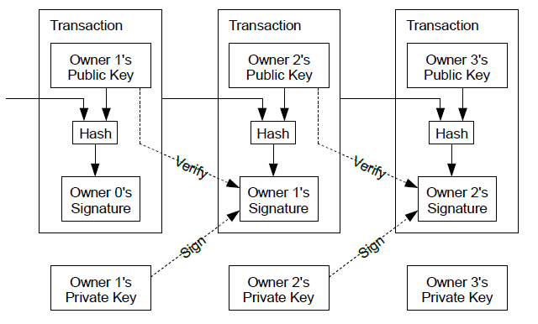
Transaction: Process
Private Key：
A private key is a secret, alphanumeric password/number used to spend/send your bitcoins to another Bitcoin address.
Public Key:
This is another alphanumeric address which is derived from private keys only by using cryptographic math functions. This address is always seen and broadcasted for receiving bitcoins. Users can make as many public addresses as they want to receive bitcoins.
Transaction:
Each owner transfers the coin to the next by digitally signing a hash of the previous transaction and the public key of the next owner and adding these to the end of the coin.
Owner 1 gives his coins to Owner 2
Bitcoin: a chain of digital signatures.
Hash：the output of the Hash function (abstract of given data)
9

Slide 10
Transaction: Double-Spending Problem
Common solution:
Introduce a trusted central authority, or mint, that checks every transaction for double spending.
→ The central authority knows ALL transactions.
Bitcoin System:
The central authority is something Satoshi tried to avoid.
Solution: all transactions are publicly announced.
The public knows ALL transactions to avoid double-spending issues.
We need a system for participants to agree on a single (transaction) history of the order in which they were received.
10

Slide 11
03
Tools & Mechanisms
Timestamp Server
Proof-of-Work
Network

Slide 12
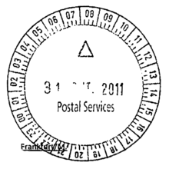
Tools/Mechanisms—Timestamp Server
Timestamp Server:
A timestamp server works by taking a hash of a block of items to be timestamped and widely publishing the hash, such as in a newspaper.
Each timestamp includes the previous timestamp in its hash, forming a chain, with each additional timestamp reinforcing the ones before it.
Pre Hash
Pre Hash
Pre Hash
12
Notes:
Blocks are linked together. Each block’s identity is based on the previous one. The linkage between blocks are very important. If some linkage breaks, it changes all the blocks after it. That is to say, if you want to change something in the past, all blocks afterwards break.

Slide 13
Tools/Mechanisms—Proof-of-Work
Proof-of-Work:
The proof-of-work involves scanning for a value that when hashed, such as with SHA-256, the hash begins with a number of zero bits.
The scanning consumes lots of computational power. → Mining!
Satoshi implemented the proof-of-work by incrementing a nonce in the block until a value is found that gives the block's hash the required zero bits.
Nonce: the "nonce" in a bitcoin block is a 32-bit (4-byte) field whose value is adjusted by miners so that the hash of the block will be less than or equal to the current target of the network.
https://anders.com/blockchain/blockchain
13

Slide 14
Tools/Mechanisms—Proof-of-Work
Proof-of-Work:
The proof-of-work also solves the problem of determining representation in majority decision making.
“one-CPU-one-vote”
Rule of decision making：
The majority decision is represented by the longest chain, which has the greatest proof-of-work effort invested in it.
Therefore, if a majority of CPU power is controlled by honest nodes, the honest chain will grow the fastest and outpace any competing chains.
To modify a past block, an attacker would have to redo the proof-of-work of the block and all blocks after it and then catch up with and surpass the work of the honest nodes.
14

Slide 15
Tools/Mechanisms—Network
Nodes ≈ Miners
①
④
When a node finds a proof-of-work, it broadcasts the block to all nodes.
New transactions are broadcast to all nodes.
②
⑤
Nodes accept the block only if all transactions in it are valid and not already spent.
Each node collects new transactions into a block.
Nodes express their acceptance of the block by working on creating the next block in the
chain, using the hash of the accepted block as the previous hash.
③
⑥
Each node works on finding a difficult proof-of-work for its block.
15

Slide 16
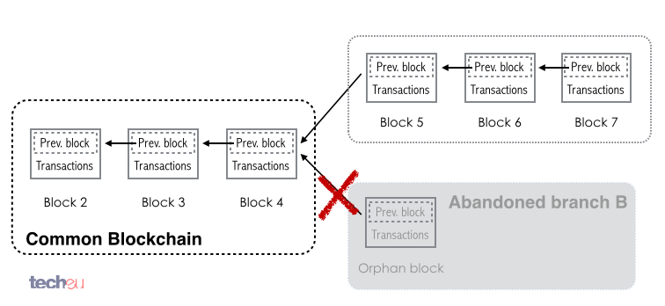
Tools/Mechanisms—Network
Nodes always consider the longest chain to be the correct one and will keep working on extending it. If two nodes broadcast different versions of the next block simultaneously, some nodes may receive one or the other first. In that case, they work on the first one they received, but save the other branch in case it becomes longer. The tie will be broken when the next proof-of-work is found and one branch becomes longer; the nodes that were working on the other
branch will then switch to the longer one.
16

Slide 17
04
Community Elements
Incentive
Privacy
Hacker Attacks

Slide 18
Community Elements—Incentive
The first transaction in a block is a special transaction that starts a new coin owned by the creator of the block.
The Bitcoin block mining reward halves every 210,000 blocks, the coin reward will decrease from 12.5 to 6.25 coins.
Estimated Reward-Drop Time: 16 May 2020 08:51:53
https://www.blockchain.com/explorer
18

Slide 19
Community Elements—Privacy
The traditional banking model achieves a level of privacy by limiting access to information to the parties involved and the trusted third party.
All transactions are public. Then how?
Keep public keys anonymous.
The public can see that someone is sending an amount to someone else, but without information linking the transaction to anyone. This is similar to the level of information released by stock exchanges, where the time and size of individual trades, the "tape", is made public, but without telling who the parties were.
19

Slide 20
Community Elements—51% Attack
An attacker trying to generate an alternate chain faster than the honest chain. Even if this is accomplished, it does not throw the system open to arbitrary changes, such as creating value out of thin air or taking money that never belonged to the attacker.
An attacker can only try to change one of his own transactions to take back money he recently spent.
*

Slide 21
⑤ Opinions
Masterpiece:
Straightforward
Instructive
Concise: only 9 pages
Great a start to learn Blockchain technology
However,
This paper is not self-contained
So you have to some research on your own
Other issues:
Money laundry
Consumption of electricity/equipment
Concentration of Mining Companies
Notes:
模板来自于风云办公 www.ppt118.com

Slide 22
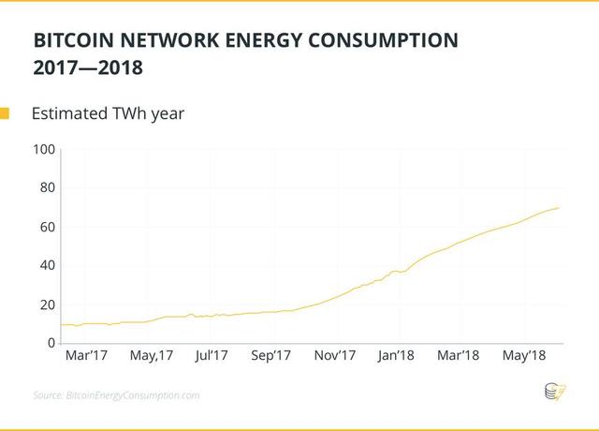
⑤ Opinions
Masterpiece:
Straightforward
Instructive
Concise: only 9 pages
Great a start to learn Blockchain technology
However,
This paper is not self-contained
So you have to some research on your own
Other issues:
Money laundry
Consumption of electricity/equipment: 0.2% in 2018, 0.3% in 2019
Concentration of Mining Companies
Notes:
模板来自于风云办公 www.ppt118.com

Slide 23
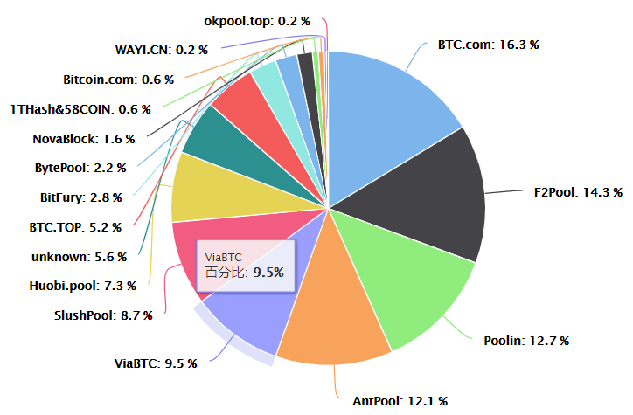
⑤ Opinions
Other issues:
Money laundry
Consumption of electricity/equipment
Concentration of Mining Companies
Notes:
模板来自于风云办公 www.ppt118.com

Slide 24
Citations
https://www.investopedia.com/terms/d/doublespending.asp
https://www.investopedia.com/terms/h/hash.asp
https://coinsutra.com/bitcoin-private-key/
https://en.bitcoin.it/wiki/Nonce
https://btc.com/stats/pool

